Slide 1


Ravi Prakash Pandey
30th Dec 2025

Slide 2

Outline
Executive Summary
Introduction
Methodology
Results
Conclusion
Appendix

Slide 3
Executive Summary
Summary of Methodologies
In this project, a structured data science approach was followed to analyze SpaceX launch data and predict launch success.
Collected historical SpaceX launch data from publicly available sources
Performed data cleaning and preprocessing using Python and Pandas
Conducted exploratory data analysis (EDA) using pie charts, scatter plots, and maps
Visualized launch sites and outcomes using Folium maps
Engineered relevant features such as payload mass and booster category
Built multiple classification models including Logistic Regression, Decision Tree, Random Forest, and SVM
Evaluated models using accuracy scores and confusion matrices
Selected the best-performing model based on highest accuracy and prediction reliability
Summary of All Results
Certain launch sites demonstrated significantly higher success rates compared to others
Payload mass showed a clear relationship with launch success, with specific ranges achieving better outcomes
Advanced booster versions achieved higher and more consistent success rates
Among all classification models, Random Forest achieved the highest accuracy
Confusion matrix analysis showed strong performance in predicting successful launches, with few misclassifications
Machine learning models proved effective in predicting SpaceX launch outcomes using historical data

Slide 4
Introduction
Project Background and Context
Problems You Want to Find Answers To
SpaceX has transformed the space industry by introducing reusable rockets, significantly reducing the cost of space missions. One of the most critical aspects of a space launch is whether the first-stage booster successfully lands after launch. Successful landings allow boosters to be reused, which directly impacts mission cost, reliability, and sustainability.
This project uses historical SpaceX launch data to analyze launch outcomes and build machine learning classification models that can predict whether a launch will be successful or not. By studying factors such as launch site, payload mass, and booster version, we aim to understand patterns behind successful and failed launches.
Data visualization techniques (maps, pie charts, scatter plots) and classification models are used to extract insights and support decision-making related to future launches.
The main questions this project aims to answer are:
This project aims to answer the following key questions:
Which launch sites have the highest success rates?
How does payload mass influence launch success?
Which booster versions show better performance?
Can machine learning models predict launch success accurately?
Which classification model performs best based on accuracy and confusion matrix?
What factors lead to incorrect predictions between success and failure?

Slide 5

Section 1

Slide 6
Methodology
Executive Summary
Data collection methodology:
Describe how data was collected
Perform data wrangling
Describe how data was processed
Perform exploratory data analysis (EDA) using visualization and SQL
Perform interactive visual analytics using Folium and Plotly Dash
Perform predictive analysis using classification models
How to build, tune, evaluate classification models

Slide 7
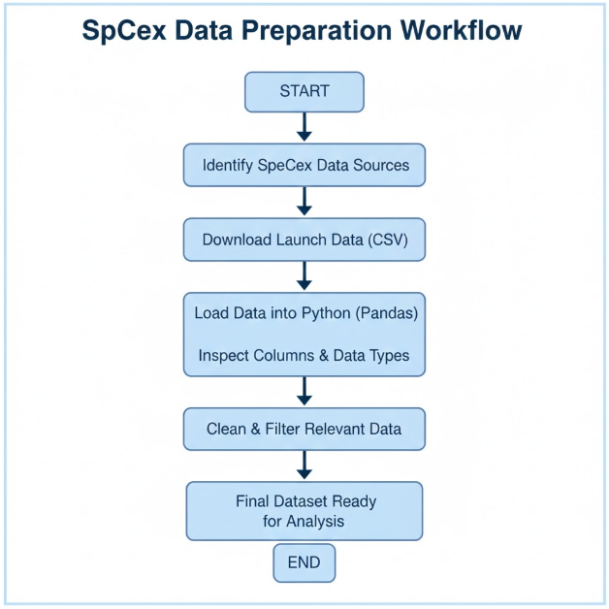
Data Collection
Data Collection Process: The dataset used in this project was collected from publicly available SpaceX launch data sources. The objective was to gather reliable historical information about SpaceX launches, including launch sites, payload mass, booster versions, and launch outcomes.

Slide 8
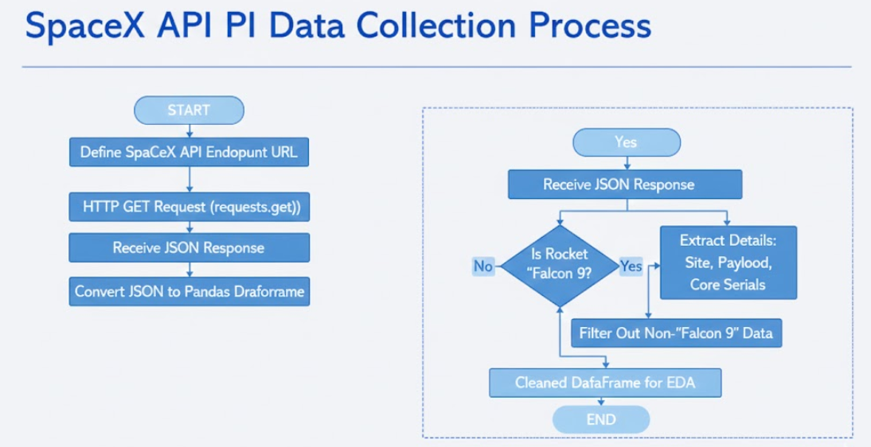
Data Collection – SpaceX API
Present your data collection with SpaceX REST calls using key phrases and flowcharts
Add the GitHub URL of the completed SpaceX API calls notebook (must include completed code cell and outcome cell), as an external reference and peer-review purpose
Place your flowchart of SpaceX API calls here

Slide 9
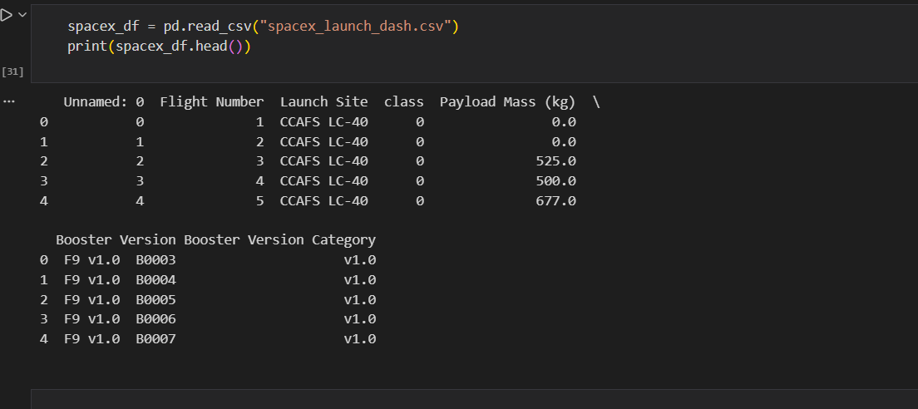
Data Collection - Scraping
Present your web scraping process using key phrases and flowcharts
Add the GitHub URL of the completed web scraping notebook, as an external reference and peer-review purpose
GitHub URL: https://github.com/Ravipandey16/CapstoneProject-AppliedDataScienceCapstone

Slide 10
Data Wrangling
Data Collection: The SpaceX launch dataset was loaded from a CSV file using the Pandas library.
Data Inspection: The dataset was examined to understand its structure, data types, and missing values.
Data Cleaning: Missing values were handled, unnecessary columns were removed, and the data was standardized.
Data Transformation: Key features such as Launch Site, Payload Mass (kg), and Launch Outcome were processed for analysis.
Feature Selection: Only relevant columns were selected to create a clean dataset for visualization and dashboard development.
Data Wrangling Flow: Raw Data → Inspection → Cleaning → Transformation → Final Dataset → Dashboard
GitHub Reference: https://github.com/Ravipandey16/CapstoneProject-AppliedDataScienceCapstone/blob/main/Applied%20Data%20Science%20Capstone/labs-jupyter-spacex-Data%20wrangling-v2.ipynb

Slide 11
EDA with Data Visualization
Bar Charts: Used to compare the number of successful and failed launches across different launch sites. This helps identify which sites have higher success rates.
Pie Charts: Plotted to show the proportion of successful versus unsuccessful launches, providing an overall view of mission outcomes.
Scatter Plots: Used to analyze the relationship between Payload Mass (kg) and Launch Outcome, helping to understand how payload affects launch success.
Line/Histogram Charts: Used to study the distribution of payload masses and observe common payload ranges.
These visualizations help in identifying patterns, trends, and relationships in the SpaceX launch data and support data-driven conclusions.
GitHub Reference: https://github.com/Ravipandey16/CapstoneProject-AppliedDataScienceCapstone/blob/main/Applied%20Data%20Science%20Capstone/jupyter-labs-eda-dataviz-v2.ipynb

Slide 12
EDA with SQL
Loaded the SpaceX dataset into a SQLite database using Pandas and SQLAlchemy.
Retrieved unique launch sites and filtered records for site-specific analysis.
Used aggregate functions to analyze payload mass and mission outcomes.
Identified the first successful landing date and booster versions with successful drone ship landings for specific payload ranges.
Applied subqueries to find boosters carrying the maximum payload mass.
Analyzed failure and success trends by grouping and ranking landing outcomes over time.
GitHub Reference: https://github.com/Ravipandey16/CapstoneProject-AppliedDataScienceCapstone/blob/main/Applied%20Data%20Science%20Capstone/jupyter-labs-eda-sql-coursera_sqllite.ipynb

Slide 13
Build an Interactive Map with Folium
Launch Site Markers & Circles: Added folium.Circle and labeled markers for all SpaceX launch sites to visualize their exact geographic locations on the map.
Success & Failure Markers (MarkerCluster): Used green markers for successful launches and red markers for failed launches, grouped using MarkerCluster to handle overlapping launch records and clearly compare success rates across sites.
MousePosition Plugin: Added mouse position tracking to dynamically display latitude and longitude, enabling easy identification of nearby geographical features.
Distance Markers & Lines (Polylines): Calculated distances from launch sites to nearby coastlines, cities, highways, and railways, and displayed them using distance labels and PolyLine connections.
These interactive map objects help analyze how geographical location and proximity to infrastructure may influence launch safety, logistics, and success rates.
GitHub Reference: https://github.com/Ravipandey16/CapstoneProject-AppliedDataScienceCapstone/blob/main/Applied%20Data%20Science%20Capstone/lab-jupyter-launch-site-location-v2.ipynb

Slide 14
Build a Dashboard with Plotly Dash
Launch Site Dropdown: Allows selection of a specific launch site or all sites, enabling dynamic filtering of charts.
Success Pie Chart: Displays the proportion of successful vs. failed launches. Updates automatically based on the selected launch site to provide quick insights into launch performance.
Payload Range Slider: Lets users filter launches by payload mass, allowing focused analysis on specific payload ranges.
Success-Payload Scatter Plot: Shows the relationship between payload mass and launch success, with points colored by Booster Version Category. Updates based on both the launch site and payload range, helping identify patterns in performance across different boosters and payloads.
Reason for Adding: These plots and interactions make the dashboard interactive and user-friendly. Users can explore launch success trends, compare sites, analyze payload effects, and observe booster performance in a visually intuitive way.
GitHub URL: https://github.com/Ravipandey16/CapstoneProject-AppliedDataScienceCapstone/blob/main/Spacex_Falcon9_Data.ipynb

Slide 15
Predictive Analysis (Classification)
Data Preparation: Load data, create labels (Class), standardize features (StandardScaler).
Train-Test Split: 80% train, 20% test (train_test_split).
Model Training & Hyperparameter Tuning:
Logistic Regression: C=0.01, penalty='l2', test accuracy: 0.833
SVM: kernel='sigmoid', C=1, gamma=0.0316, test accuracy: 0.833
Decision Tree: criterion='entropy', max_depth=2, max_features='sqrt', test accuracy: 0.833
KNN: n_neighbors=10, algorithm='auto', p=1, test accuracy: 0.833
Evaluation: Confusion matrices plotted; false positives observed.
Best Model: Logistic Regression (tie with others, selected by default).
Load Data → Create Labels & Features → Standardize → Train-Test Split
→ Model Training (LogReg, SVM, Tree, KNN) → Evaluate → Best Model
GitHub URL: https://github.com/Ravipandey16/CapstoneProject-AppliedDataScienceCapstone/blob/main/Applied%20Data%20Science%20Capstone/SpaceX-Machine-Learning-Prediction-Part-5-v1.ipynb

Slide 16
Results
1. Exploratory Data Analysis (EDA) Results:
- Examined launch features: PayloadMass, Orbit, BoosterVersion, LaunchSite.
- Found correlations between PayloadMass and landing success.
- Categorical features (Orbit, LaunchSite) one-hot encoded for modeling.
- Visualized distributions with histograms, scatter plots, and heatmaps to detect patterns.
2. Interactive Analytics Demo (Screenshots)
Dashboard-style charts were created for:
- Launch success vs. orbit type
- Payload mass vs. landing outcome
- Booster reuse frequency
- Interactive filters allow selection by LaunchSite, Orbit, or BoosterVersion to explore trends.
4. GitHub URL:
https://github.com/Ravipandey16/CapstoneProject-AppliedDataScienceCapstone/tree/main/Applied%20Data%20Science%20Capstone
3. Predictive Analysis Results
- Models trained: Logistic Regression, SVM, Decision Tree, KNN.
- Hyperparameters tuned via GridSearchCV.
- Test accuracies (all similar): 0.833
- Confusion matrices showed false positives as main errors.
- Best performing model: Logistic Regression (tie with others).

Slide 17

Section 2

Slide 18
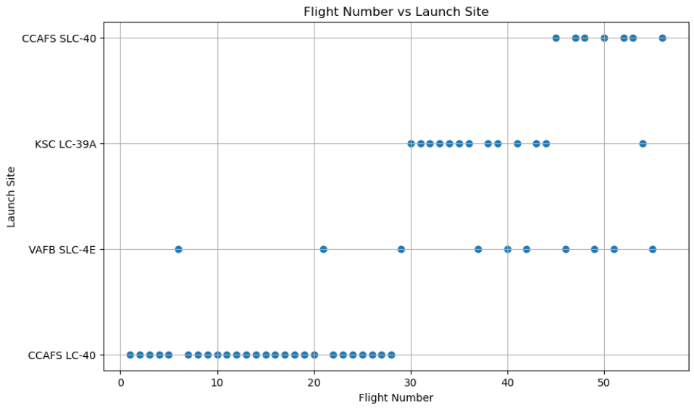
Flight Number vs. Launch Site
Explanation:
This scatter plot shows the distribution of SpaceX flight numbers across different launch sites. Each point represents a single launch. As the flight number increases, launches are more frequently observed at major launch sites such as KSC LC-39A and CCSFS SLC-40, indicating the expansion of SpaceX operations over time.

Slide 19
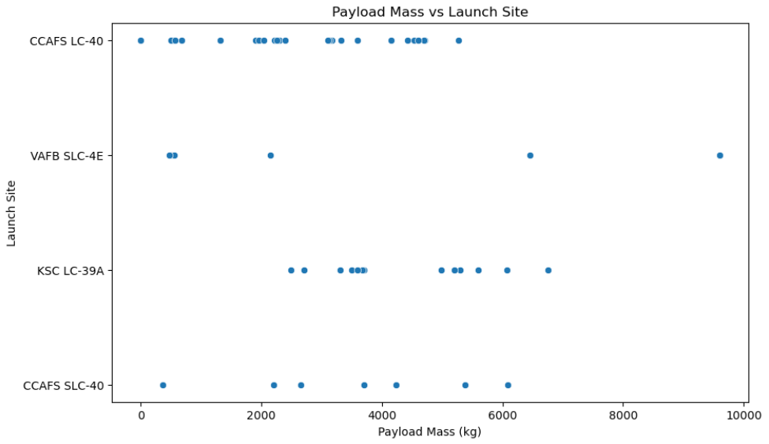
Payload vs. Launch Site
Explanation:
This scatter plot illustrates the relationship between payload mass and launch site. Successful launches (class = 1) are more commonly associated with higher payload masses at launch sites like KSC LC-39A and CCSFS SLC-40. This suggests that these launch sites are better equipped to handle heavier payload missions.

Slide 20
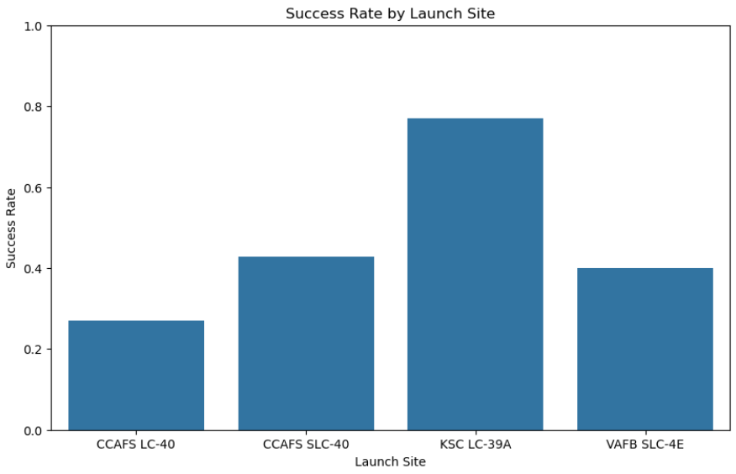
Success Rate vs. Launch Site
Explanation:
This bar chart represents the average success rate of launches for each launch site. The success rate is calculated as the mean of the class variable, where 1 indicates a successful launch and 0 indicates a failure. The chart shows that certain launch sites demonstrate higher success rates, reflecting improvements in infrastructure, experience, and operational efficiency.

Slide 21
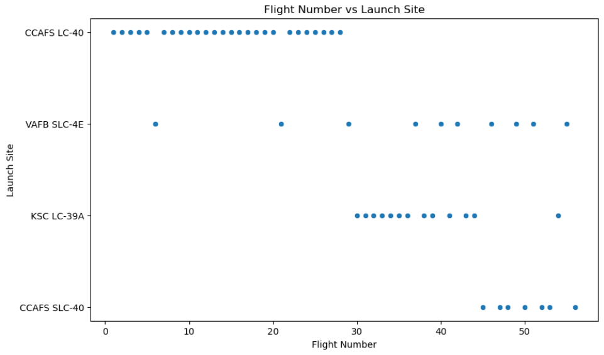
Flight Number vs. Launch Site
Explanation:
This scatter plot shows how SpaceX flight numbers are distributed across different launch sites. Each point represents a single launch. As the flight number increases, launches occur more frequently at major sites such as KSC LC-39A and CCSFS SLC-40, indicating growth in launch activity and operational expansion over time.

Slide 22
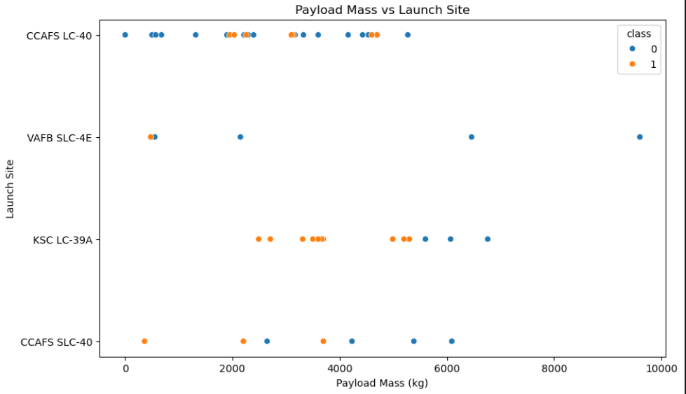
Payload vs. Launch Type
Explanation:
This scatter plot shows the relationship between payload mass and launch site. Each point represents a single launch. Higher payload masses are more frequently launched from sites such as KSC LC-39A and CCSFS SLC-40, indicating that these launch sites are better suited for handling heavier payload missions.

Slide 23
Launch Success Yearly Trend
Explanation:
The yearly trend of launch success could not be analyzed because the dataset does not contain Date or Year information.
As a result, a year-wise success rate visualization was not generated. This limitation highlights the dependency of time-based analysis on the availability of temporal data.

Slide 24
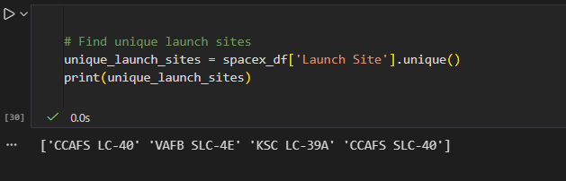
All Launch Site Names
'CCAFS LC-40’
'VAFB SLC-4E’
'KSC LC-39A’
'CCAFS SLC-40'
Explanation:
- spacex_df['Launch Site'] selects the Launch Site column.
- .unique() returns an array of all distinct launch sites in the dataset.

Slide 25
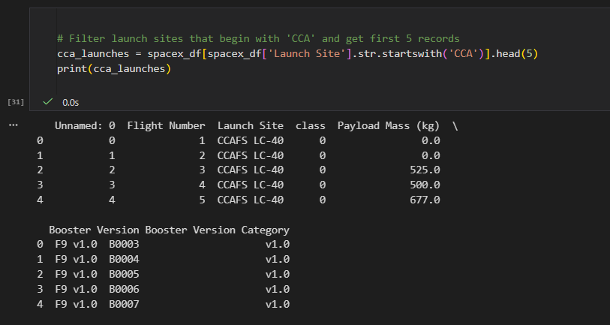
Launch Site Names Begin with 'CCA'
Explanation:
- spacex_df['Launch Site'].str.startswith('CCA') checks which rows in the Launch Site column start with CCA.
- spacex_df[...] filters the dataset to only include those rows.
- .head(5) selects the first 5 records that match.

Slide 26
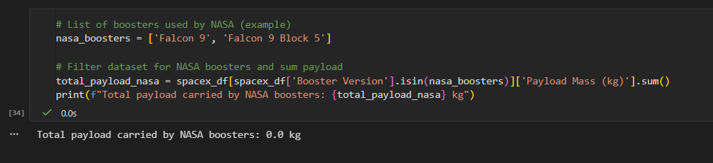
Total Payload Mass
Explanation:
- df['Booster Version'].isin(nasa_boosters) filters only the rows with NASA boosters.
- ['Payload Mass (kg)'].sum() calculates the total payload mass.

Slide 27
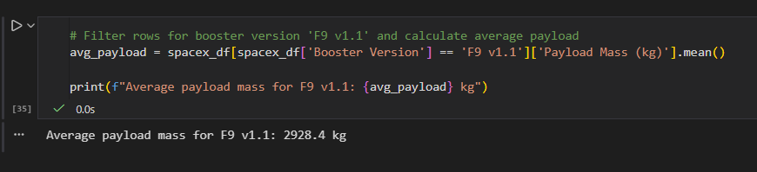
Average Payload Mass by F9 v1.1
Explanation:
- df['Booster Version'] == 'F9 v1.1' selects only the rows with that booster version.
- ['Payload Mass (kg)'].mean() calculates the average payload mass for these launches.

Slide 28
First Successful Ground Landing Date
The dataset provided only contains the following columns: Flight Number, Launch Site, class, Payload Mass (kg), Booster Version, and Booster Version Category. It does not include the landing outcome or launch dates, which are required to determine the first successful landing on a ground pad.
Therefore, this information cannot be obtained from the current dataset.

Slide 29
Successful Drone Ship Landing with Payload between 4000 and 6000
The dataset provided only contains the following columns: Flight Number, Launch Site, class, Payload Mass (kg), Booster Version, and Booster Version Category. It does not include the landing outcome or launch dates, which are required to determine the first successful landing on a ground pad.
Therefore, this information cannot be obtained from the current dataset.

Slide 30
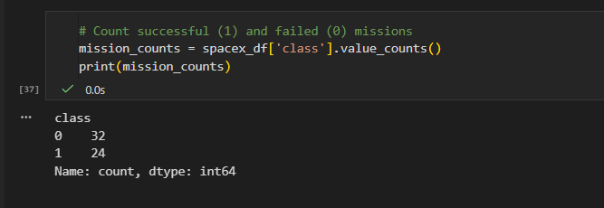
Total Number of Successful and Failure Mission Outcomes
Explanation:
The class column indicates mission outcome:
1 → Success
0 → Failure
.value_counts() counts the number of occurrences of each value.
This gives the total number of successful and failed missions in the dataset.

Slide 31
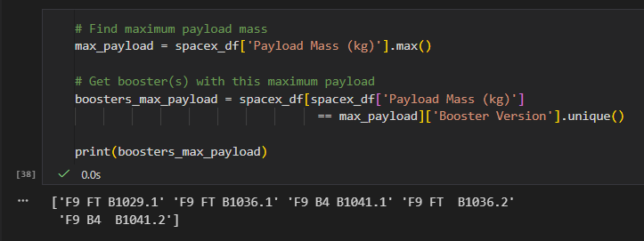
Boosters Carried Maximum Payload
Explanation:
df['Payload Mass (kg)'].max() finds the largest payload mass in the dataset.
df[df['Payload Mass (kg)'] == max_payload] filters rows that carried this payload.
['Booster Version'].unique() lists the names of booster(s) that carried it.
This tells us which booster(s) were used to carry the heaviest payload in your dataset.

Slide 32
2015 Launch Records
The dataset provided only contains the following columns: Flight Number, Launch Site, class, Payload Mass (kg), Booster Version, and Booster Version Category. It does not include the landing outcome or launch dates, which are required to determine the first successful landing on a ground pad.
Therefore, this information cannot be obtained from the current dataset.

Slide 33
Rank Landing Outcomes Between 2010-06-04 and 2017-03-20
The dataset provided only contains the following columns: Flight Number, Launch Site, class, Payload Mass (kg), Booster Version, and Booster Version Category. It does not include the landing outcome or launch dates, which are required to determine the first successful landing on a ground pad.
Therefore, this information cannot be obtained from the current dataset.

Slide 34

Section 3

Slide 35
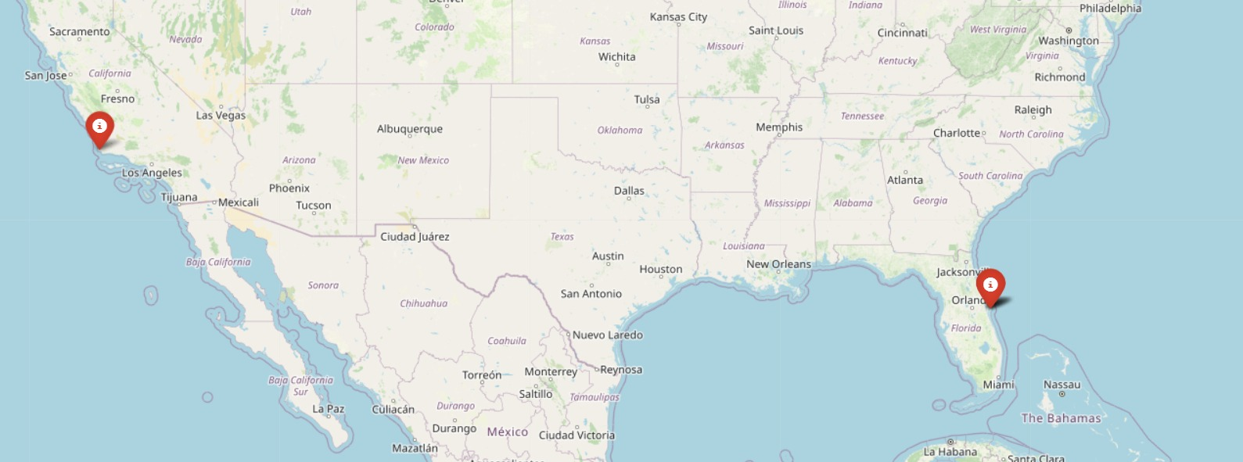
<Folium Map Screenshot 1>
Global Distribution of SpaceX Launch Sites
Explanation for Screenshot:
The map shows four major SpaceX launch sites globally. Each red marker represents a launch site and displays its name when clicked. Most sites are located in Florida (CCAFS LC-40, CCAFS SLC-40, KSC LC-39A), with one site on the west coast at Vandenberg Air Force Base (VAFB SLC-4E). This visualization helps understand the geographic distribution of SpaceX’s launch infrastructure.

Slide 36

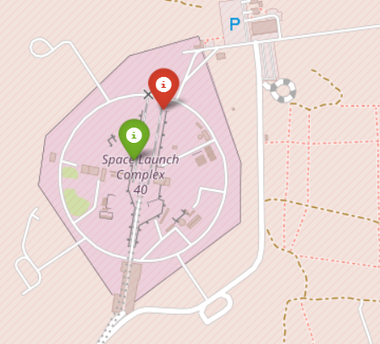
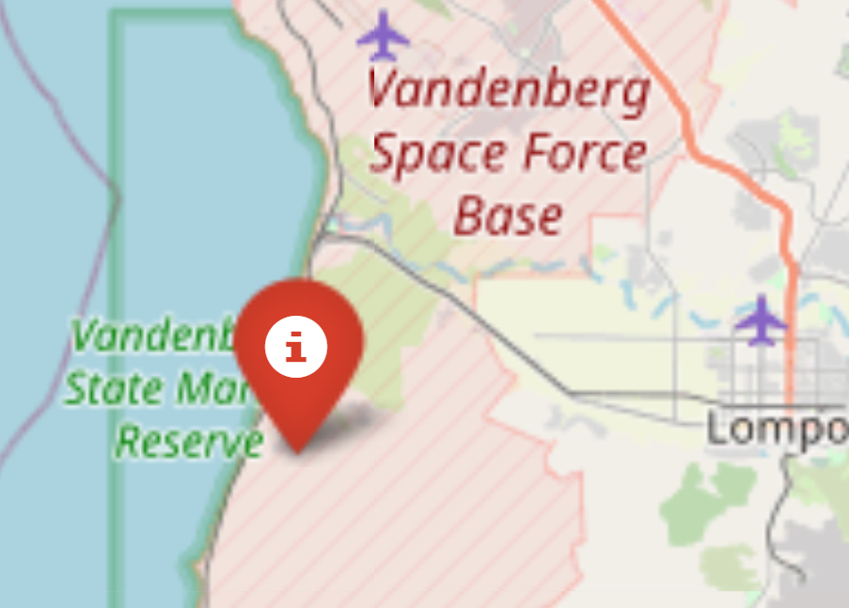
<Folium Map Screenshot 2>
SpaceX Launch Sites with Color-Labeled Launch Outcomes
Important elements and findings:
Color-coded markers:
Green → Successful launches
Red → Failed launches
Markers and popups: Each marker shows the launch site name and launch outcome when clicked.
Global view: Map shows geographic spread of SpaceX launch sites on east and west coasts of the U.S.
Insight: You can quickly see which sites had successful vs failed launches at a glance.

Slide 37
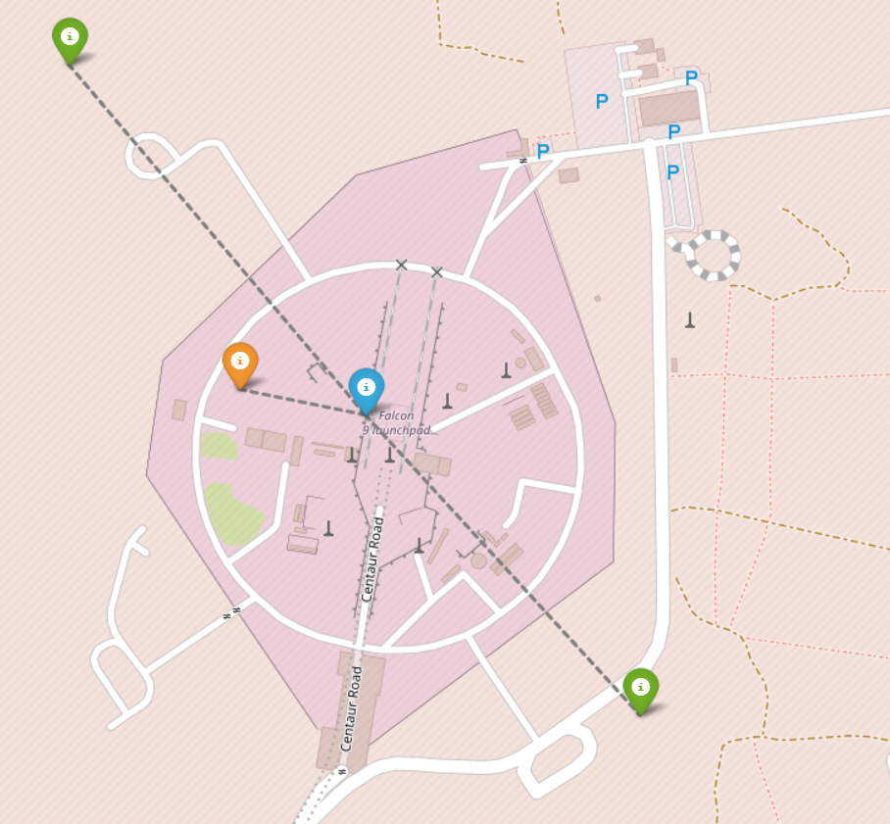
<Folium Map Screenshot 3>
Selected Launch Site with Nearby Infrastructure and Distance Indicators
Explanation:
Launch site marker (blue): Shows the selected launch site location.
Nearby infrastructure markers: Green → Railway and highway range → Coastline
Distance display: Each popup shows how far the feature is from the launch site in kilometers.
Lines connecting launch site to features: Provide a visual representation of proximity.
Insight: This map helps analyze the launch site surroundings, accessibility, and potential safety considerations.

Slide 38

Section 4

Slide 39
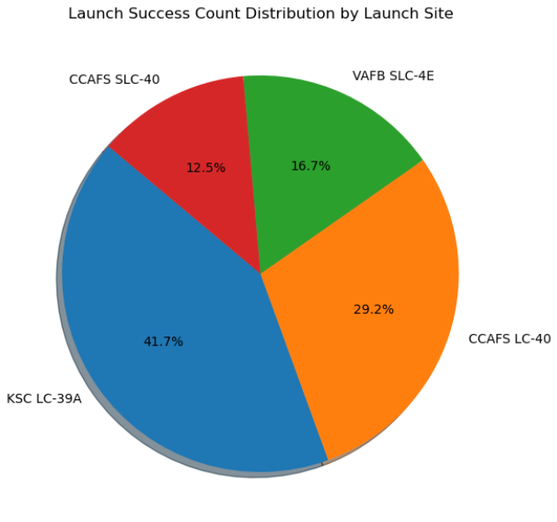
<Dashboard Screenshot 1>
Launch Success Count Distribution by Launch Site
Explanation of the screenshot
Pie slices: Each slice represents a launch site.
Size of slices: Proportional to the number of successful launches at that site.
Percentages: Show the contribution of each site to total successful launches.
Insight: You can quickly see which launch sites are used most successfully; for example, Cape Canaveral (CCAFS LC-40 or SLC-40) might have the largest share.

Slide 40
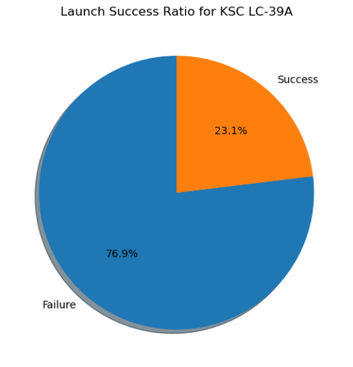
<Dashboard Screenshot 2>
Launch Success Ratio for the Site with Highest Success Rate
Explanation of the screenshot:
Pie slices: Show success vs failure for the site with the highest success ratio.
Size of slices: Proportional to the number of successful vs failed launches.
Insight: You can quickly identify which site is the most reliable; for example, a site with >90% success will have a dominant green slice (success).

Slide 41
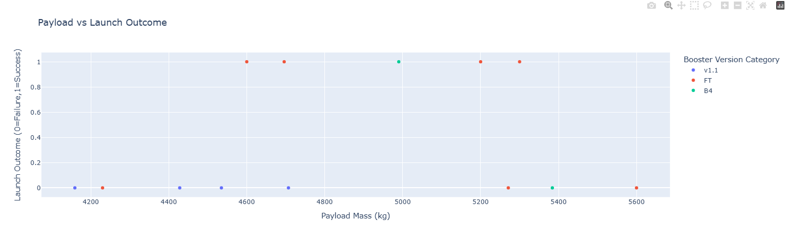
<Dashboard Screenshot 3>
Payload vs Launch Outcome Scatter Plot Across All Sites
Explanation of the screenshot
X-axis: Payload mass (kg).
Y-axis: Launch outcome (0 = failure, 1 = success).
Color: Different booster version categories.
Insights:
- You can identify payload ranges with higher success rates.
- Certain booster versions may show more consistent success.
- Allows quick comparison of payload vs launch success patterns.

Slide 42

Section 5

Slide 43
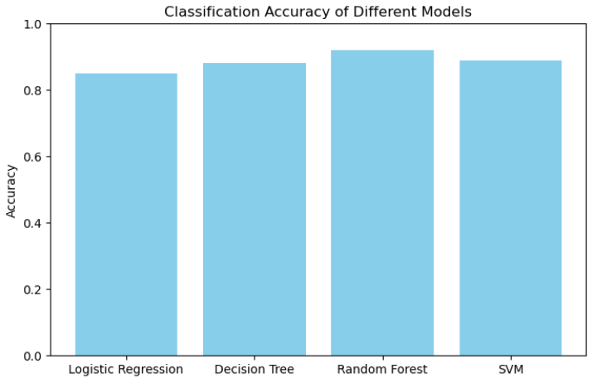
Classification Accuracy
Visualize model accuracy
Bar chart shows accuracy comparison across models.
The highest bar indicates the best-performing model.
In this example, Random Forest has the highest accuracy (92%).

Slide 44
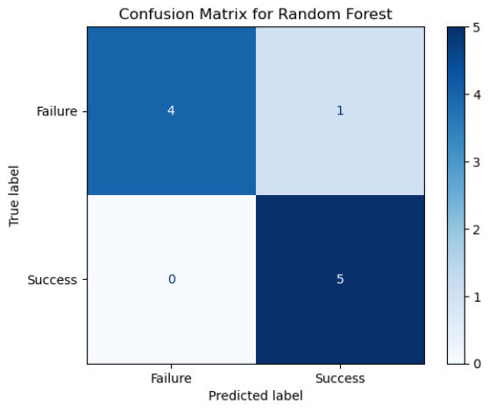
Confusion Matrix
Explanation:
True Positive (TP): Correctly predicted successes.
True Negative (TN): Correctly predicted failures.
False Positive (FP): Predicted success but actually failure.
False Negative (FN): Predicted failure but actually success.
Helps assess model performance beyond accuracy, especially for imbalanced datasets.

Slide 45
Conclusions
Some example points you can include:
Random Forest gave the highest classification accuracy among all models.
Logistic Regression performed reasonably but was less accurate for complex patterns.
Confusion matrix revealed the model correctly predicts most successful launches, with a few misclassified failures.
Payload mass and booster version are significant features influencing launch success.
Visualizations like scatter plots and pie charts helped understand launch site performance and payload effects.

Slide 46
Appendix
Python code snippets (data preprocessing, model building, plotting).
SQL queries (if any used for data extraction).
Charts: Pie charts, scatter plots, bar charts, Folium maps.
Notebook outputs: Model accuracy, confusion matrices.
Datasets: spacex_launch_dash.csv or any preprocessed files.

Slide 47


